Slide 1
MPP USER INTERFACE

Slide 2

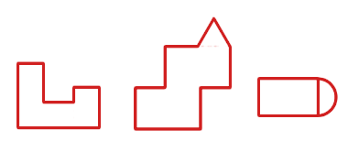
The Area of Irregular Shapes
Home
Warm-up
Lesson
Quiz

Slide 3
Warm-Up
Home
How to calculate the area of a square ?
A = ½ b × h
A = s²
A = w × h
A = pi × r²
Warm-up
Lesson
Quiz
Check
Back
Next

Slide 4
Warm-Up
Home
How to calculate the area of a square ?
A = ½ b × h
A = s²
A = w × h
A = pi × r²
Warm-up
Lesson
Quiz
Check
Wrong! Try again!
Back
Next

Slide 5
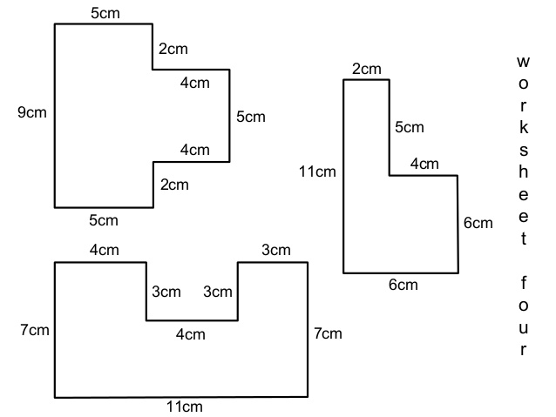
Lesson
Home
Find the area of the figure
Warm-up
Lesson
Quiz
Back
Next

Slide 6
Lesson
Home
Find the area of the figure
Warm-up
A1
Lesson
Quiz
A2
Method 1
Back
Next

Slide 7
Lesson
Home
Find the area of the figure
A1 = w × h
= 2 cm × 5 cm
= 10 cm²
A2 = s²
= (6 cm) ²
= 36 cm²
Warm-up
A1
Lesson
Quiz
A2
Method 1
Back
Next

Slide 8
Lesson
Home
Find the area of the figure
A1 = w × h
= 2 cm × 5 cm
= 10 cm²
A2 = s²
= (6 cm) ²
= 36 cm²
Warm-up
A1
Lesson
A2
A = A1 + A2
= 10 cm² + 36 cm²
= 46 cm²
The total area is 46 cm²
Quiz
Method 1
Back
Next

Slide 9
Quiz
Home
Find the area of the figure
Warm-up
Lesson
Quiz
Answer: cm²
Check
Back
Next

Slide 10
Quiz
Home
Find the area of the figure
Warm-up
Lesson
Quiz
Answer: 10 cm²
Check
Wrong! Try again!
Back
Next

Slide 11
